Slide 1
Girls for STEM
Week 4

Slide 2
Schedule
3:30-3:45 Activity Explanation
3:45-4:00 Worktime
4:00-4:15 Experiment Time
4:15-4:20 Reflection
4:20-4:25 Clean-Up
4:30 Pickup

Slide 3



Icebreaker
Will save activity for later…

Slide 4
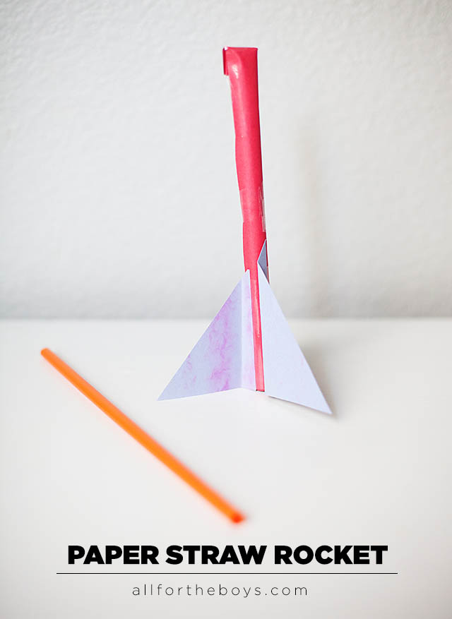
Week 4 Experiment:
Paper Rockets!!!!
REVIEW: What is force?
Acceleration = Force/ Mass
Push or pull on an object
What is mass?
The amount of “stuff” in an object
What is acceleration?
How much something is speeding up or slowing down
What makes the force for the rocket?
You! Your breath!

Slide 5
Let’s get started!!!!!!

Slide 6
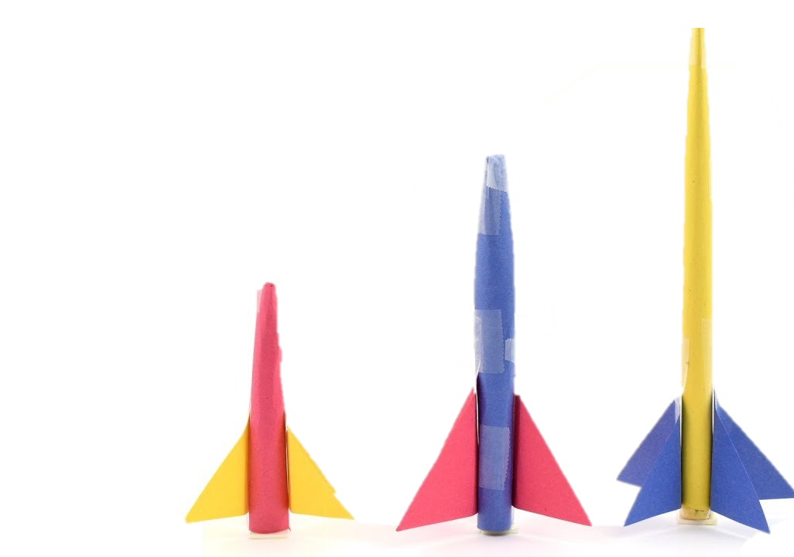
What are we doing?
We are making/testing rockets!
Grab a big straw and tape the end of one side
  Now you have a working rocket!
Customize your rocket:
  Cover your rocket with construction paper
  Add fins (use template or make your own)
  Change the rocket size
  Add a nose (will demo)
  Add weight
Test it out!

Slide 7
Challenges!
Try to hit the target with your rocket. How are you changing distance your rocket goes?
Try to launch your rocket as far as you can. What makes your rocket go farther? What did the rockets that went the furthest have in common?
Try to launch your rocket the highest it can go. What makes your rocket go higher? What did the rockets that went the furthest have in common?

