Slide 1
Girls for STEM

Slide 2
Schedule
3:30-3:50 Activity Explanation
3:50-4:10 Worktime
4:10-4:25 Clean-up
4:30 Pickup

Slide 3
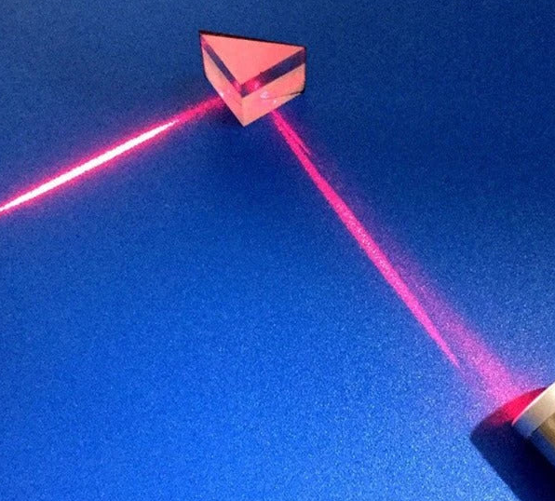
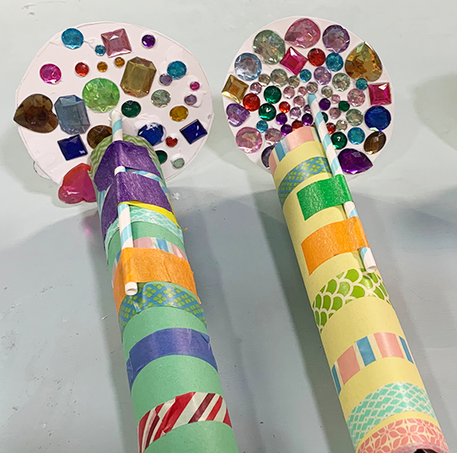
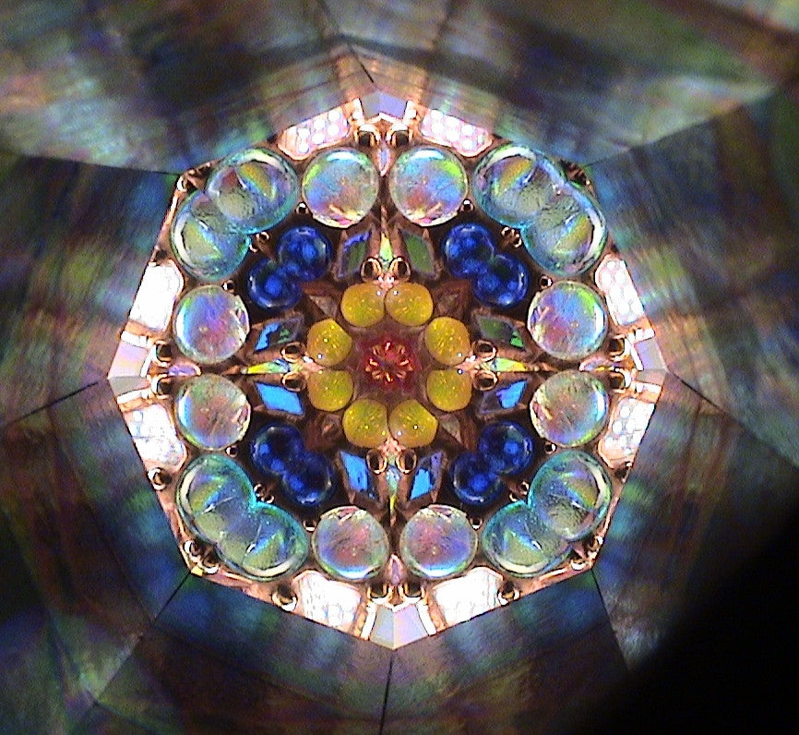
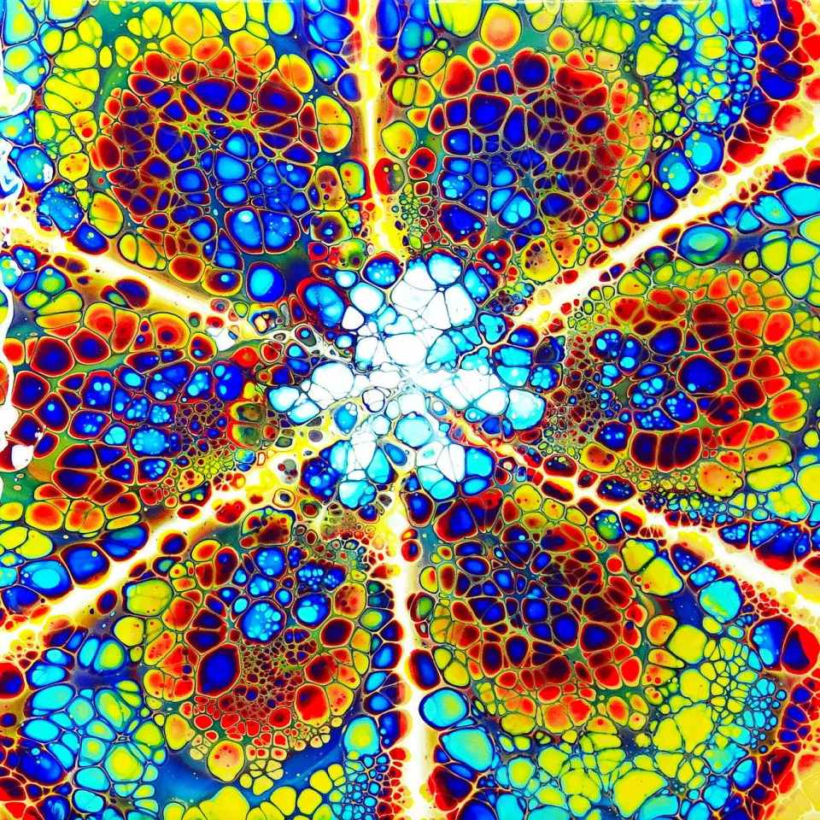
Week 5 Experiment:
DIY Kaleidoscopes!!!!
What is reflection?
Reflection:
  When something (like light) bounces back from a surface
  What are some reflective things you can think of?
  What is a prism?
Prism:
  A 3D shape that bends light and color
  Our prism creates repeating patterns
What shape is our prism in?
- Triangle!

Slide 4
What are we doing?
We are making our own kaleidoscopes!
Grab a paper roll, 3 strips of white paper and foil paper, and a glue stick
Glue the foil paper around each piece of white paper
Tape the 3 pieces into a triangle and put the triangle inside the paper roll
Grab one of the disks and put glue on one side
Go to glitter station and press glue side into glitter
Tape straw onto paper roll and attach disks
Spin disk and watch the colors!

Slide 5
Let’s get started!!!!!!

