Slide 1
Girls for STEM
Week 3

Slide 2
Schedule
3:15-3:25 Icebreaker
3:25-3:40 Experiment Explanation
3:40-4:05 Worktime
4:05-4:25 Challenge
4:30 Pickup

Slide 3
Icebreaker
What color best describes you?
What color does the person to your right think describes you? The person on your left?

Slide 4
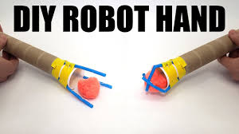
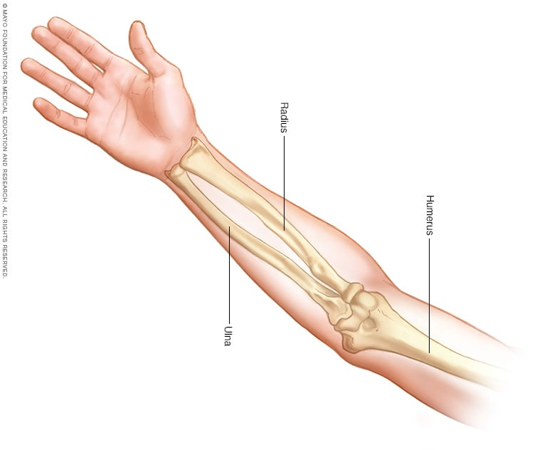
Week 2 CHALLENGE:
DIY Robot Arm!!!!!
Make a fist. Now spread your fingers. How do we do that?
Tension:
  The force of pull on an object
What are tendons?
Tendons connect muscles to bones
Human Arms vs. Robot Arms
Arm Bones/ Muscle
Cardboard:
String:
Straws:
Cup:
Tendons
Fingers
Palm

Slide 5
What are we doing?
We are going to build our own robot arms!
We will make 1 “finger” together (the others are already made)
Figure out how you want to orient your “fingers” and tape them to the cup
Decorate the “arm”!!
Put the cup with the straws attached into the cardboard role and tape.
CHALLENGE WITH ROBOT ARM!

Slide 6
CHALLENGE???

Slide 7
Let’s get started!!!!!!

