Slide 1
Girls in STEM

Slide 2
Schedule
3:15-3:35 Icebreaker
3:35-3:45 Experiment Explanation
3:45-4:15 Worktime
4:15-4:25 Enjoy treat!
4:30 Pickup

Slide 3
Icebreaker
Name
﻿﻿What do you remember about last week?
FUN ACTIVITY!!

Slide 4
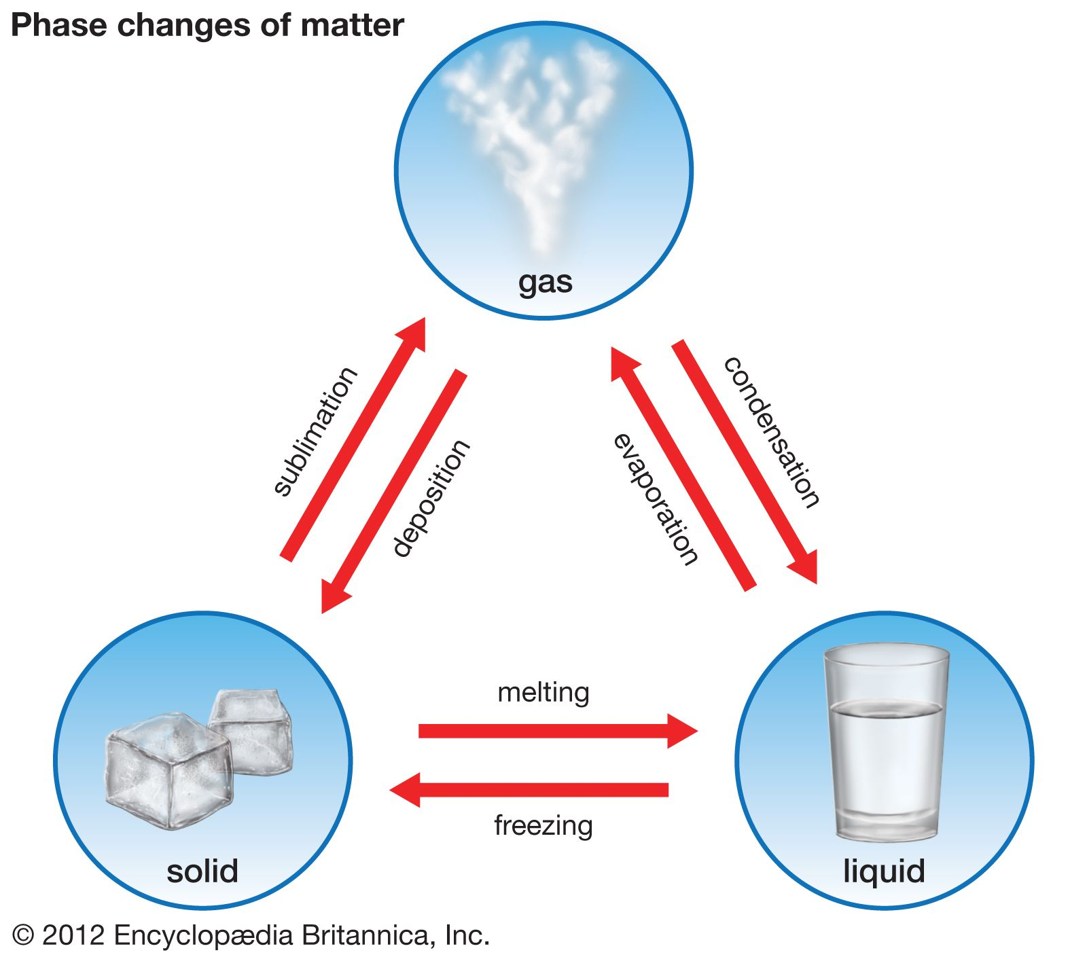
Week 2 Experiment:
Homemade Ice Cream!
What is a “phase change’?
A phase change is when matter changes from one state to another (solid, liquid, gas)
What is freezing point?
The temperature when matter changes from a liquid to a solid
Water’s freezing point: 32 degrees F
Freezing Point Depression…
  The freezing point of water is LOWERED when salt is added
  The ice can melt and takes in the heat from the ice cream, making the ice cream colder

Slide 5
What are we doing?
We are making our own ice cream!
Mix the ingredients in the smaller bag…
  1 c. half-and-half
  2 Tbsp. granulated sugar
  1/2 tsp. pure vanilla extract
  3 c. ice
Fill the gallon bag halfway full of ice.
Add 1/3 cup of salt to the ice
Put the smaller bag in the gallon bag of ice and seal
Shake for 10 minutes
Serve and enjoy!

Slide 6
Let’s get started!!!!!!

