Slide 1
Girls for STEM

Slide 2
Schedule
3:15-3:30 Experiment Introduction
3:30-3:40 Worktime
  (3:40-4:20) Sun-time
3:45-4:05 Icebreaker
4:05-4:15 Experiment Explanation
4:15-4:20 Clean Up
4:20-4:30 Enjoy treat!
4:30 Pickup

Slide 3
Let’s get started!!!!!!

Slide 4
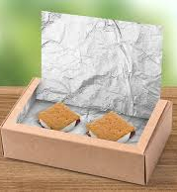
What are we doing?
We are building our own mini-oven to make s’mores!
Take your box, cutting off parts of the top to make a hinge
Line the bottom with black paper
Cover the flap and line inside walls of the box with aluminum foil
MAKE S’MORES!
Cover s’mores in pizza box with plastic wrap
Prop up flap so that sun reflects into the box
Let cook for around 40 minutes
Eat!

Slide 5
Icebreaker
Name
﻿﻿What do you remember about last week?
FUN ACTIVITY!!

Slide 6
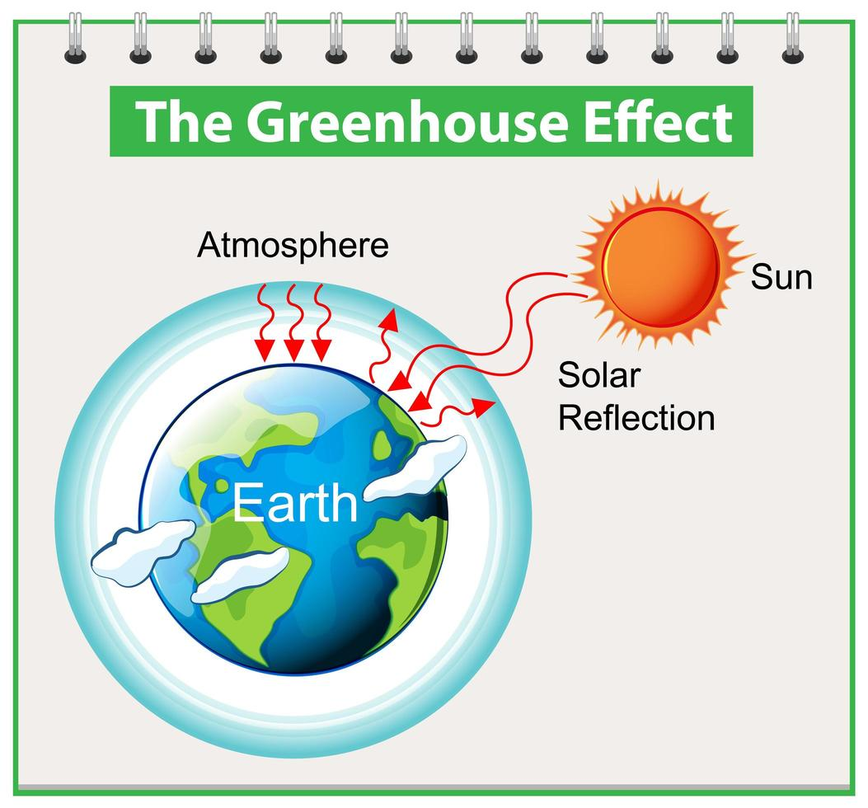
Week 2 Experiment:
Solar Oven!
What is “solar energy”?
“Solar energy” is energy from the sun. It comes to earth in the form of light and heat.
Parts of Our Boxes:
Holds the sun’s heat
Black Paper:
Aluminum Foil:
Reflects the sunlight toward the box
Traps the sun’s heat inside the box
Plastic Wrap:
In our world:
  Humans use solar energy as a renewable source of energy
    Keeps our environment safe!
  Greenhouse Gases in our atmosphere are like the plastic wrap
    Do not allow heat to escape from the atmosphere

