Slide 1
Girls for STEM

Slide 2
Schedule
3:30-3:50 Activity Explanation
3:50-4:10 Worktime
4:10-4:25 Clean-up
4:30 Pickup

Slide 3
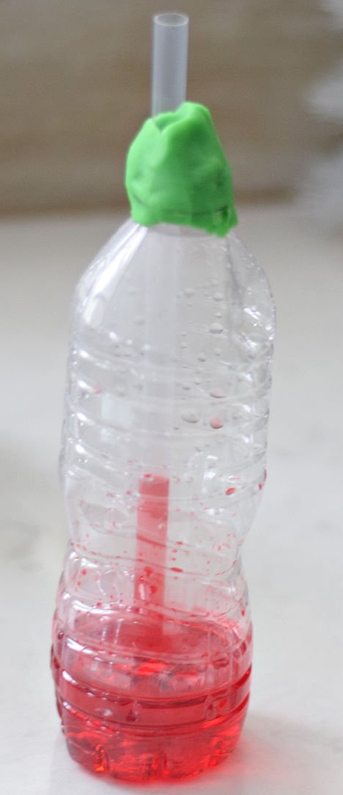
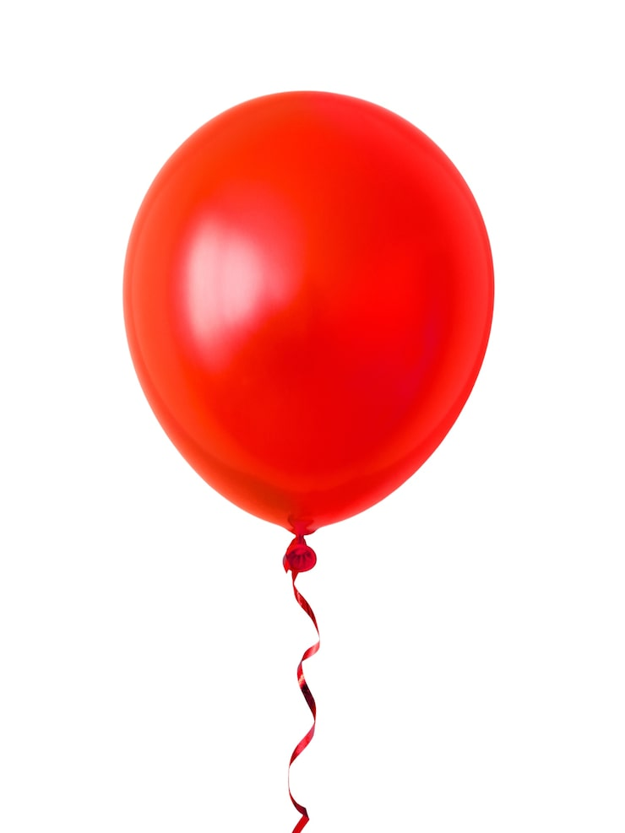
Week 6 Experiment:
Homemade Thermometers!!!!
What is a thermometer?
  Something that measures temperature
  How does a thermometer work?
When the weather gets warm, the liquid gets warm and expands up the tube
When the weather gets cold, the liquid cools down and shrinks back down the tube
  What three things affect how much the liquid moves?
  Pressure
  Temperature
  Volume

Slide 4
What are we doing?
We are making our own thermometers!
Pour ½ cup of water, ½ cup of rubbing alcohol, and food coloring into an empty glass bottle
Put a straw in the bottle (in the mixture but not touching the bottom of the container)
Use modeling clay to secure the straw
Start measuring the temperature of…
  The room?
  The hallway?
  Your house?

Slide 5
Let’s get started!!!!!!

