Slide 1
Girls in STEM

Slide 2
Schedule
3:15-3:35 Icebreaker (with special guests)
3:35-3:45 Experiment Explanation
3:45-4:20 Worktime
4:20-4:25 Clean Up
4:30 Pickup

Slide 3
Icebreaker
Name
Grade
Favorite Class
STEM-Involvement (for high-schoolers)
Group Activity (with the high schoolers ☺)!!!

Slide 4
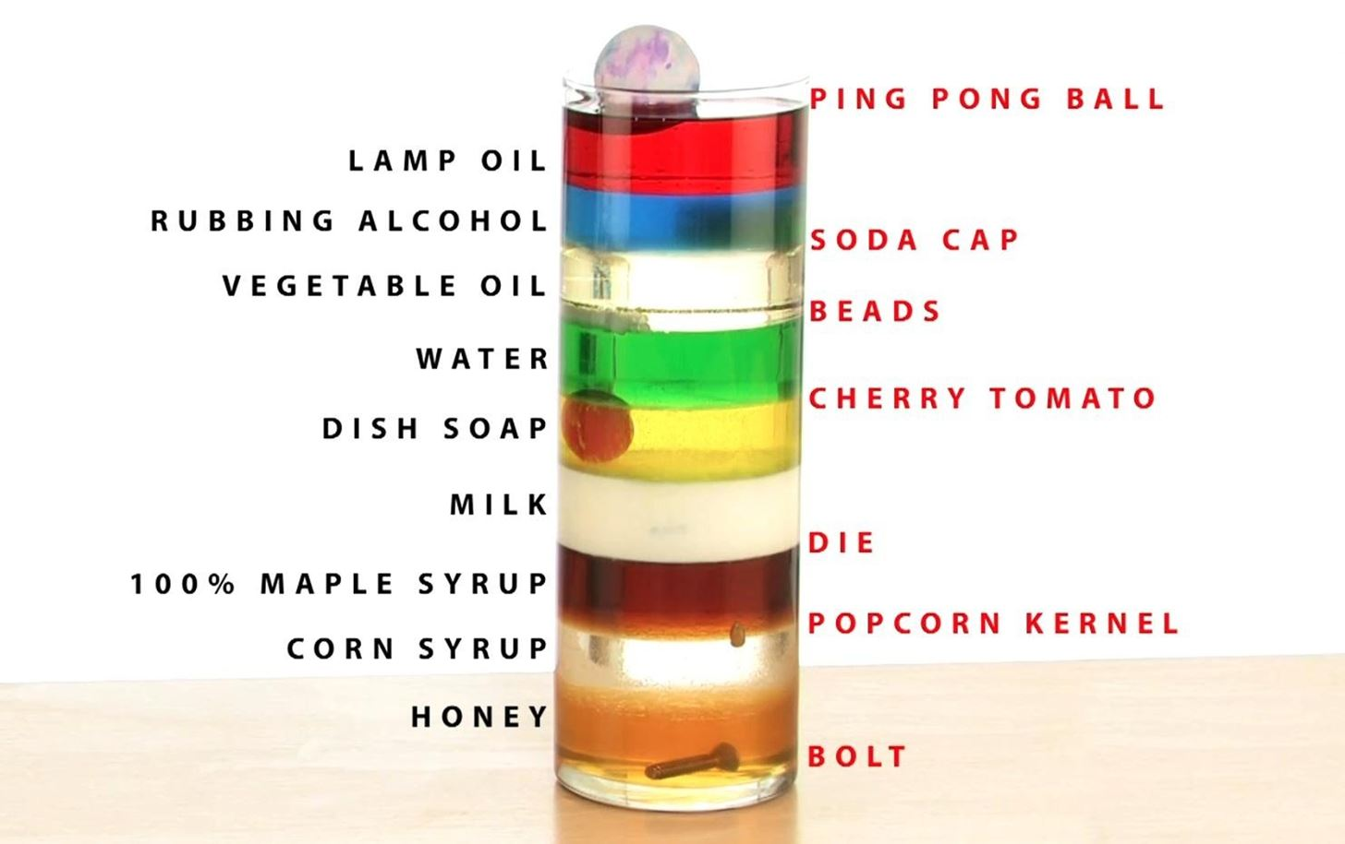
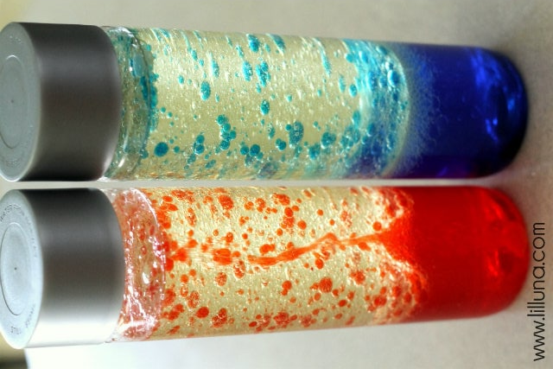
Week 4 Experiment:
DIY Lava Lamps!!!!!
What is a “density”?
Density is how tightly something is packed together
- Like a beach ball versus a basketball
Which states of matter are the densest?
Solids are the densest, then liquids, then gases.
What does hydrophobic mean?
It mean “afraid of water”
What does hydrophilic mean?
It mean “love for water”

Slide 5
What are we doing?
We are going to make our own lava lamps!!
Fill the bottles up with water a quarter of the way
Add food coloring and/or mix-ins and shake to combine with the water
Slowly pour in the vegetable oil almost to the top of the bottle
Break the seltzer tablets in pieces and drop them in the bottle
Watch and enjoy!

Slide 6
Let’s get started!!!!!!

