Slide 1
Girls for STEM

Slide 2
Schedule
3:30-3:50 Get-to-know Everyone!
3:50-4:00 Experiment Explanation
4:00-4:25 Worktime
4:25-4:30 Clean Up
4:30 Pickup

Slide 3
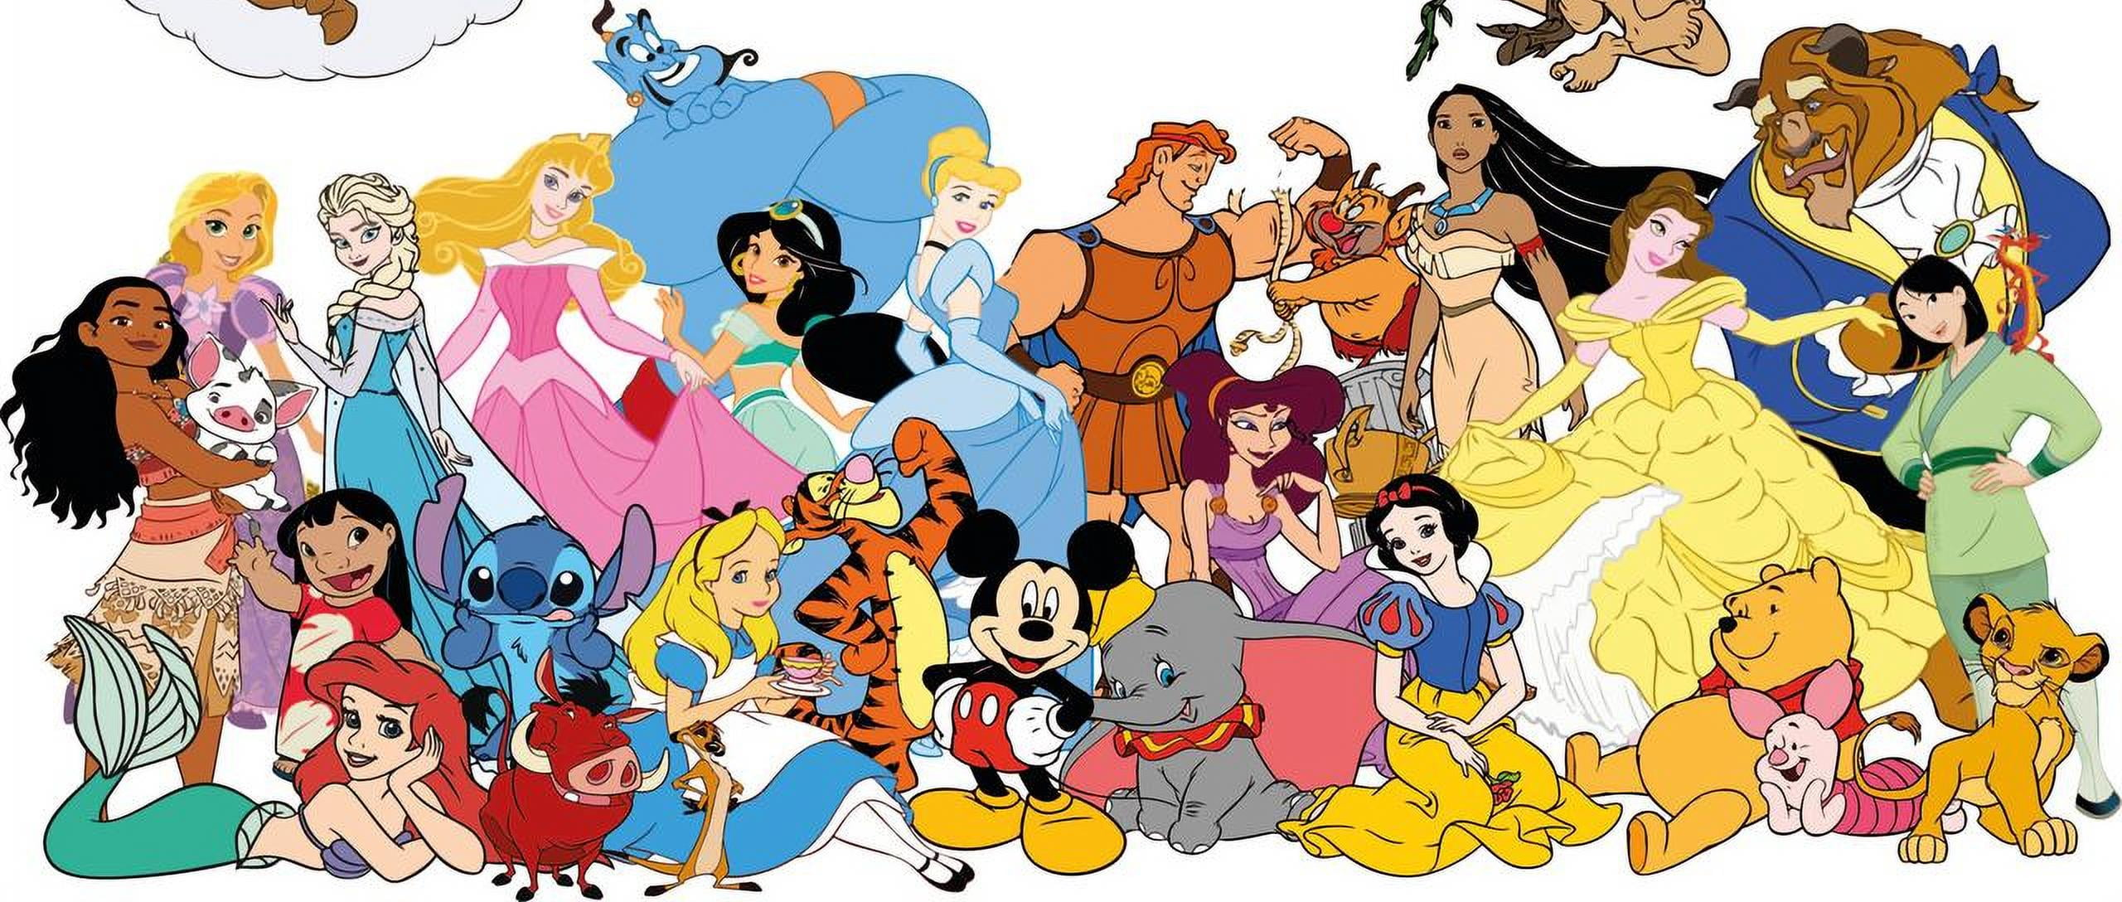



Icebreaker
Name
Grade
Why you signed up for this club?
Describe yourself in Disney characters….

Slide 4
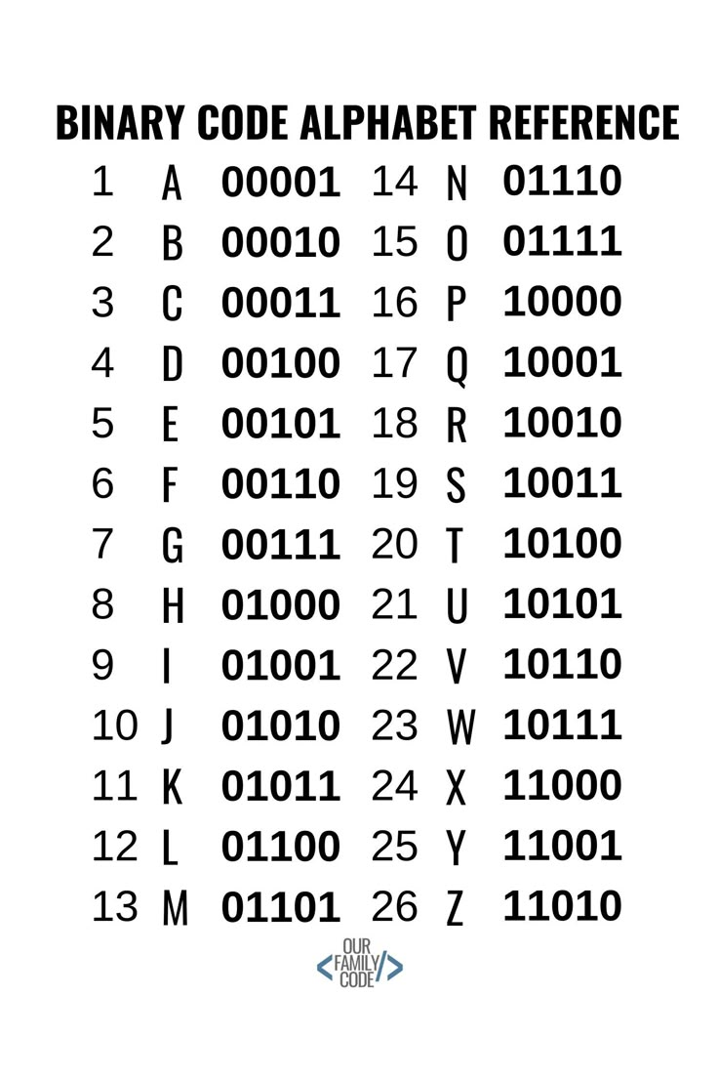
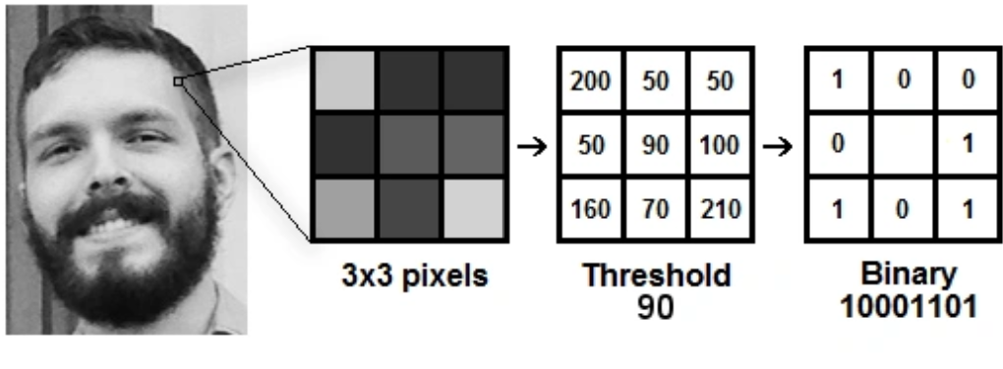
Week 1 Experiment:
Binary Code Bracelets!!!!
What is binary code?
Binary means involving 2 things
- Binary Code is a “language” written with 0’s and 1’s
Each 0 or 1 is called a bit
Every app, videogame, picture, song, and more is stored in as a long chain of binary code
Fun Facts:
  What are some other “languages” use binary patterns?
  What is this word: 10011 10100 00101 01101
Morse Code and Braille
STEM!

Slide 5
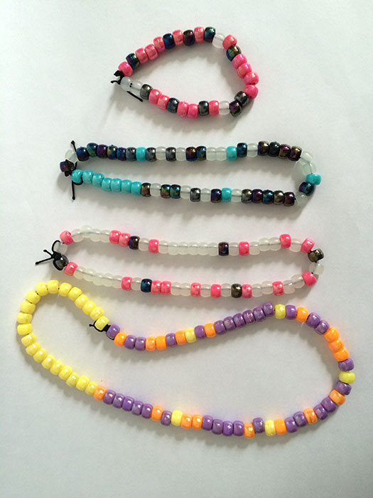
What are we doing?
We are making bracelets!
Pick 2 colors and assign one colors to be 0 and one color to be 1
Pick what word/phrase you want to spell
Put a white bead at the start of your bracelet and a black bead in between every letter
Use the binary code refence sheet to help you figure out the pattern for each letter
Ask me if you need help!

Slide 6
Let’s get started!!!!!!

Slide 7
Binary Code Bracelets:
Pick 2 colors and assign one colors
to be 0 and one color to be 1
Pick what word/phrase you want to spell
Put a white bead at the start of your bracelet and a black bead in between every letter
Use the binary code reference sheet to help you figure out the pattern for each letter
Ask me if you need help!

